Slide 1
Measurement – Linear Measure
Miss Lum
Year 11 Essentials

Slide 2

Learning Outcomes
1.3.1 Choose and use appropriate metric units of length, their abbreviations, conversions between them, and their appropriate levels of accuracy, such as mm for building and other trade contexts, cm for textiles
1.3.2 Estimate lengths
1.3.3 Convert between metric units of length and other length units for simple practical purposes. For example, 1 inch ≈ 2.54 cm

Slide 3
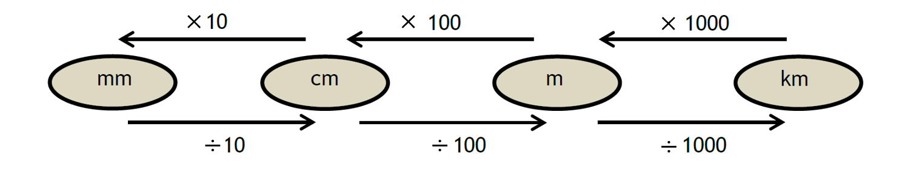
24
7
30
Linear Measurement
Date: 06/03/2018
EQ – What is Linear Measurement?
In Australia we use the metric system to measure length.
1 millimetre ≡ 1 mm
10 millimetres = 1 centimetre ≡ 1 cm
1000 mm = 100 cm = 1 metre ≡ 1 m
1 000 000 mm = 100 000 cm = 1000 m = 1 kilometre ≡ 1 km
Different units of measurements of length can be converted

Slide 4
Think, Write, Pair, Share
Using the Baldivis Secondary College’s Sports Carnival as our example:
Think of the events and the lengths of measurements.
Write down the events and lengths.
Share these ideas with someone next to you. - While sharing your answers, discuss why centimetres and millimetres are not used.
We will have a whole group discussion on the choice and use of measurement lengths.

Slide 5
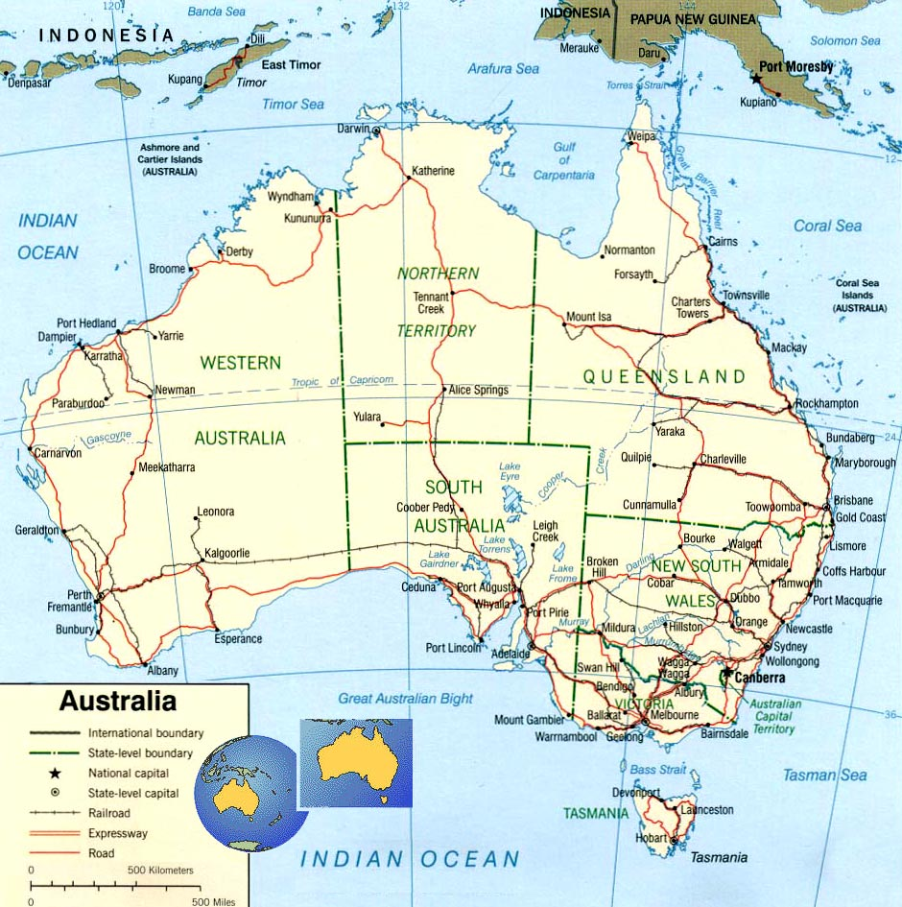
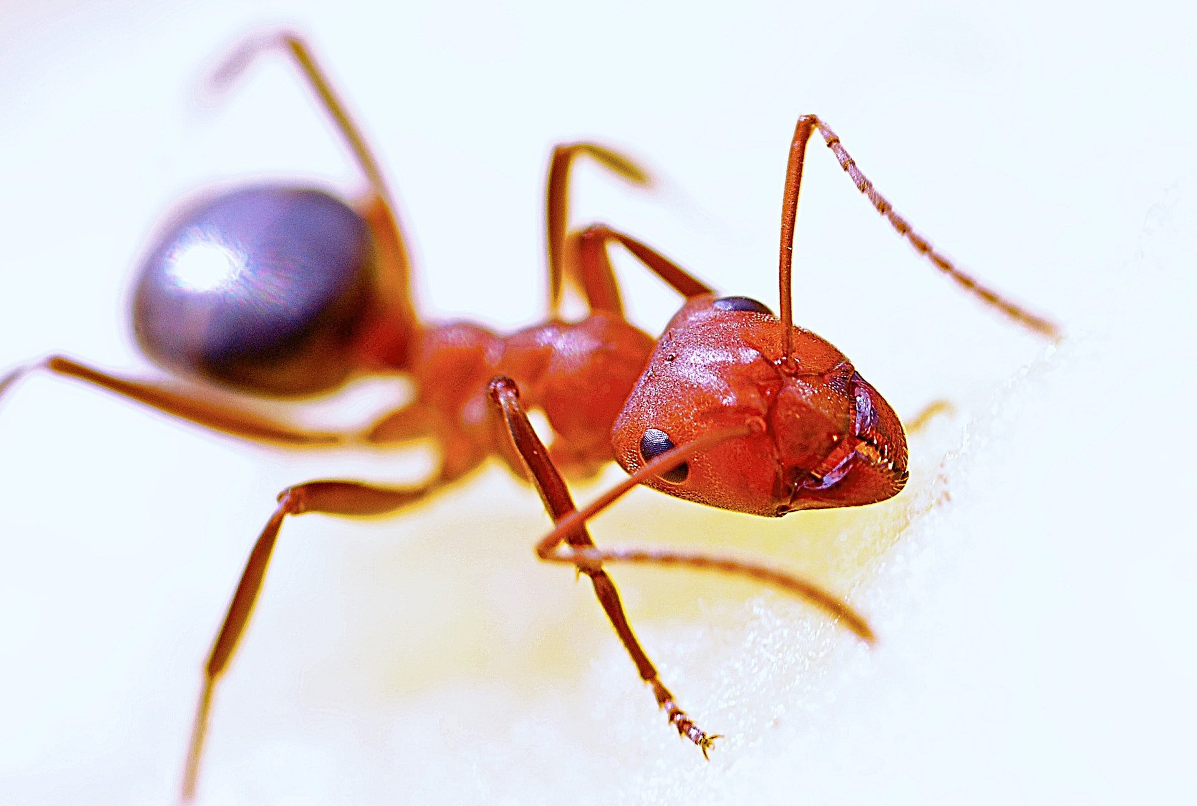
24
7
30
Linear Measurement
Date: 06/03/2018
EQ – What is Linear Measurement?
Choosing an appropriate unit of measurement is important.
The length of the Australian coastline is 25 760 km.
Centimetres and millimetres are not practical units to describe this length as there would be many digits. It is most efficient to present the information using fewer digits.
Similarly you would not use kilometres to describe the length of a bull ant even though it can give you a very painful bite!
This Photo by Unknown Author is licensed under CC BY-SA

Slide 6
Practical Activity
Estimate the length of the whiteboard area of the classroom.
Estimate the height of the desk you are sitting at.
Estimate the width of one of the classroom’s windows.
Write these estimates down. These will be compared to measurements.
How do your estimates compare?

Slide 7
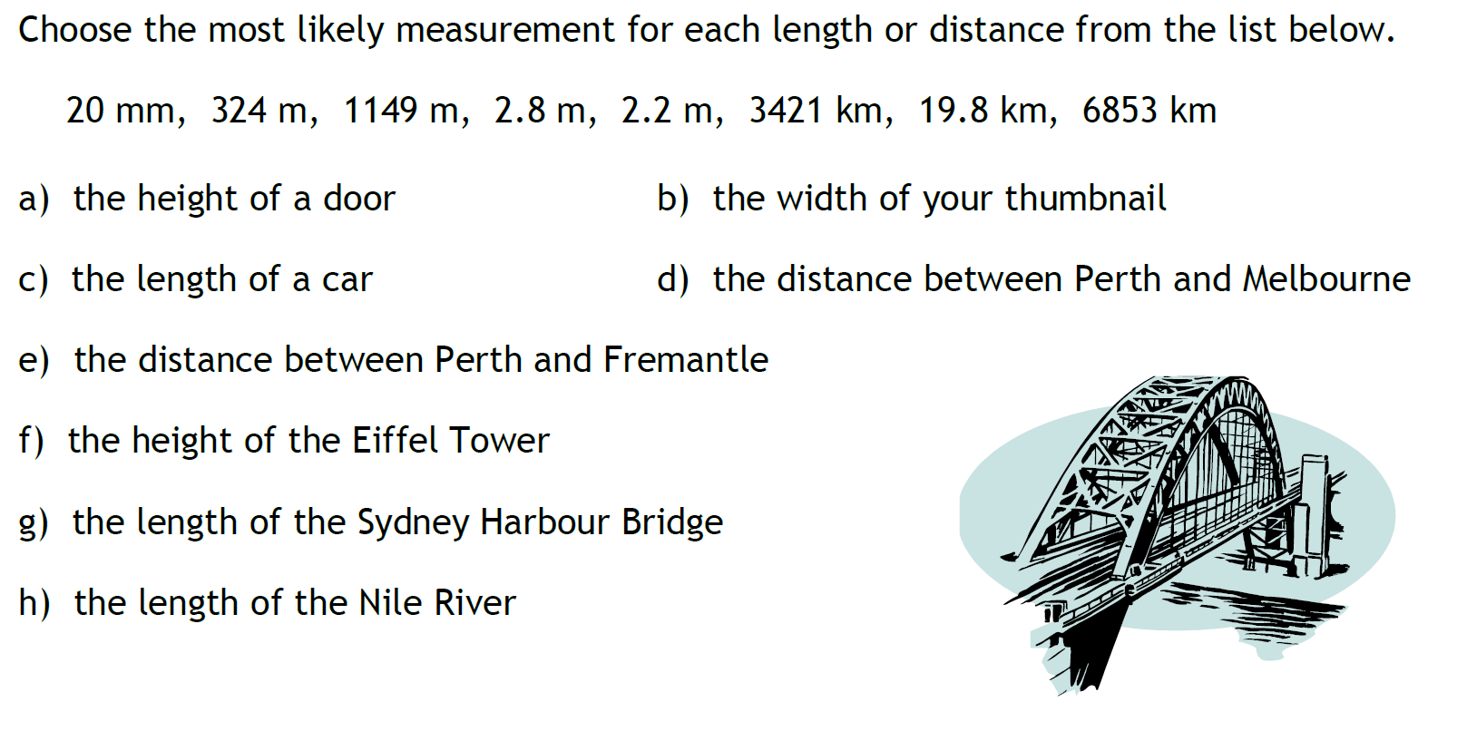
Task

Slide 8
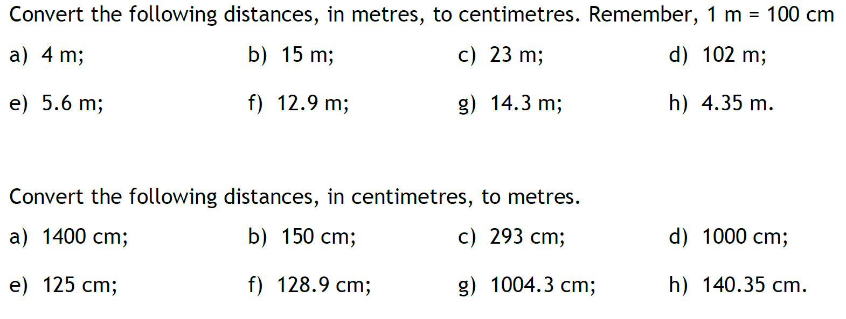
Task

Slide 9
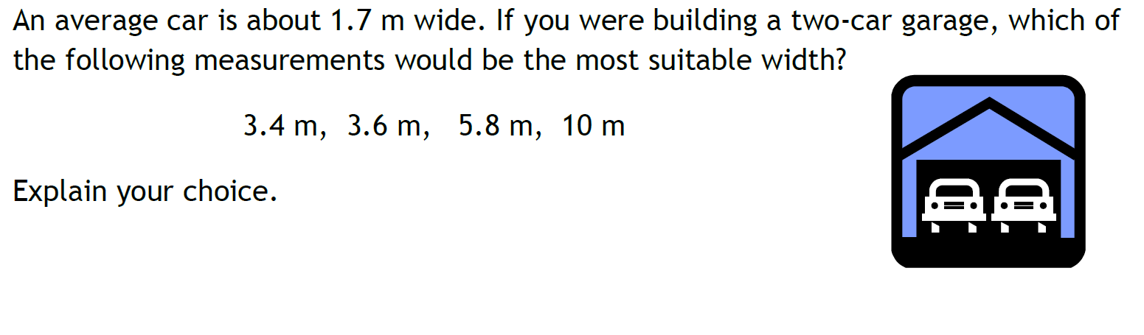
When Will I Ever Need This?
Notes:
This is a prompt for a 5 – 10 min class discussion. Focus on literacy and numeracy skills used to communicate ideas.

Slide 10
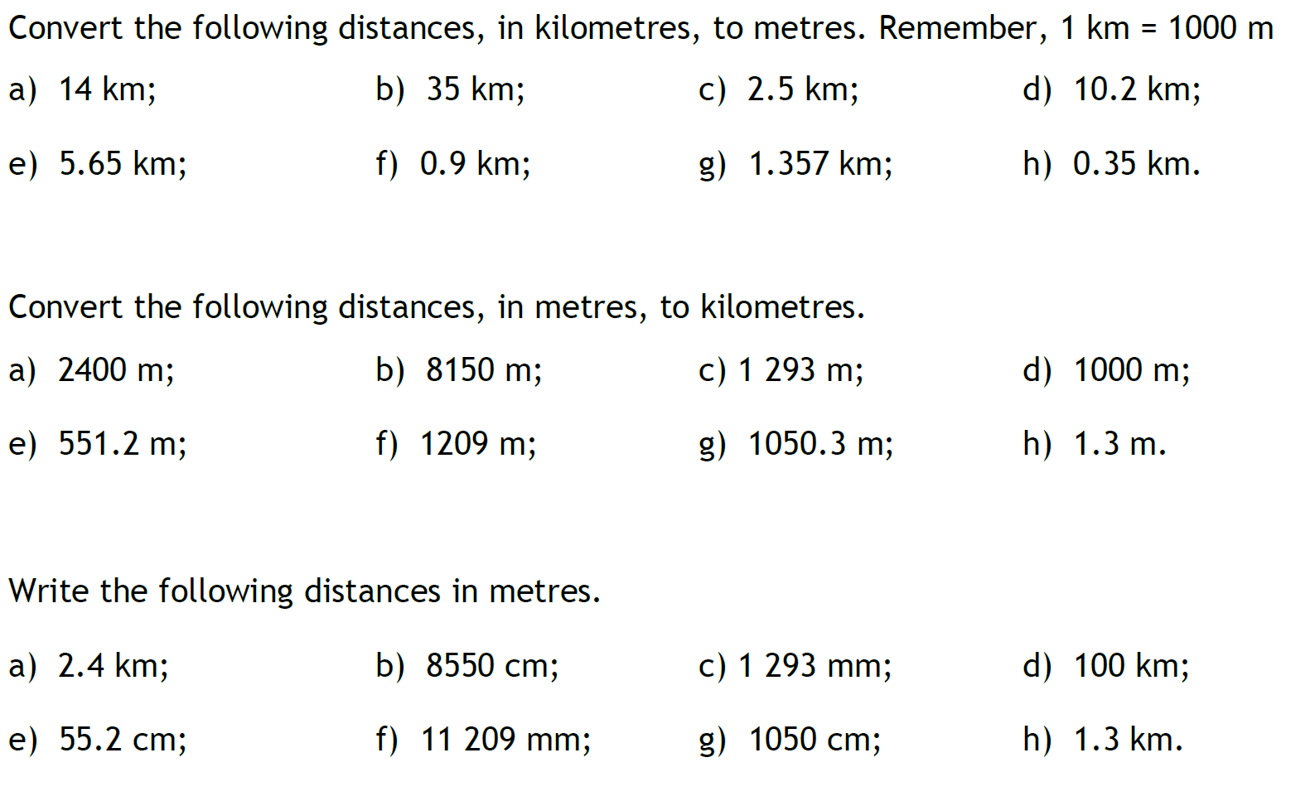
Task

Slide 11

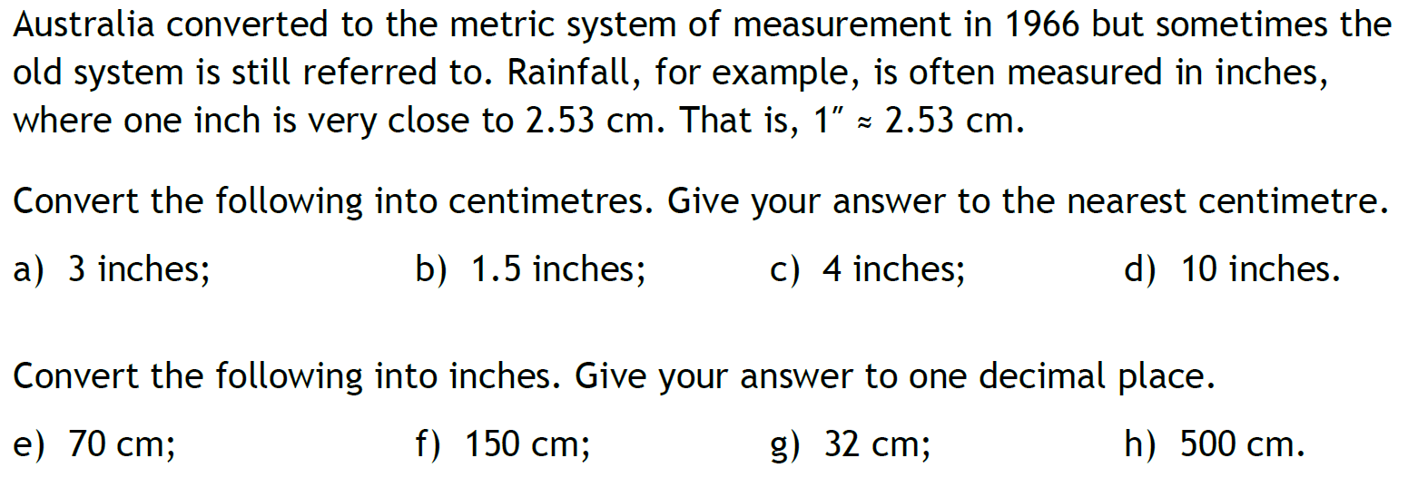
Task

Slide 12
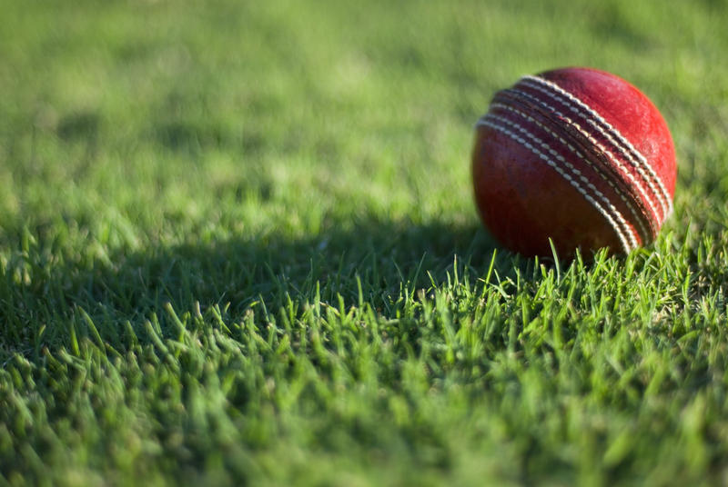
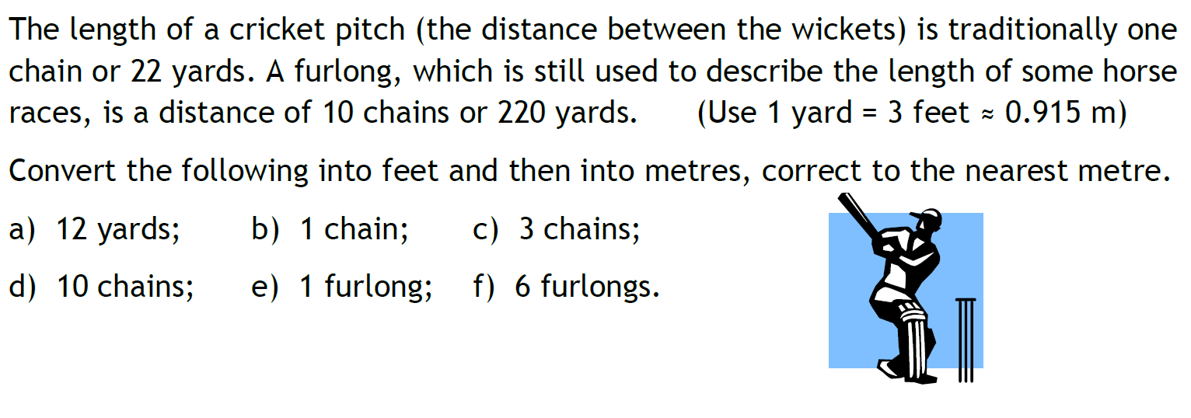
Task

